Slide 1
React.js
https://training.stdio.vn

Slide 2
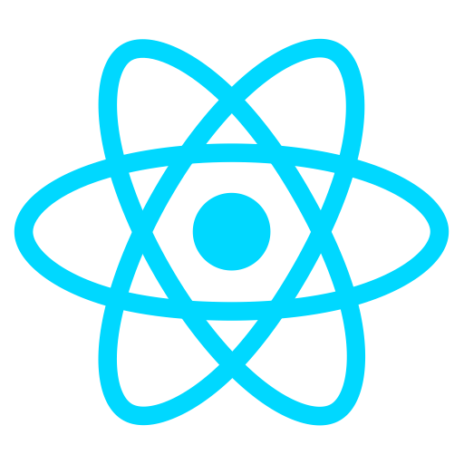

Slide 3
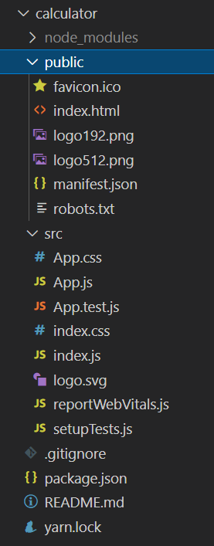
Create React.js project
Introducing React.js
npx create-react-app calculator
npm start
Entry point → index.js

Slide 4
Node.js
Node.js® is a JavaScript runtime built on Chrome's V8 JavaScript engine. Node.js uses an event-driven, non-blocking I/O model that makes it lightweight and efficient.
To run a JavaScript file with Node.js
node hello.js
NPM – the package manager for Node.js
Check version
node -v
npm -v

Slide 5
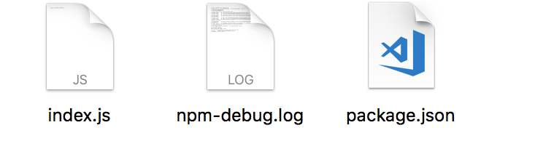
Basic npm command
Create Node.js project
npm init
package.json file
Declare packages dependencies of project.
Specify version number of each package.
Allow to make build command
Install package dependencies
npm install
https://www.npmjs.com

Slide 6
Manage package with npm
Install new package
npm install <package-name>
Optional argument
-g: install package globally
--save: install and add package name to package.json
Uninstall package
npm uninstall <package-name>
Optional agrument
-g: remove package globally
--save: package will be removed from package.json
--no-save: package will NOT be remove from package.json
Notes:
npm install math.js

Slide 7
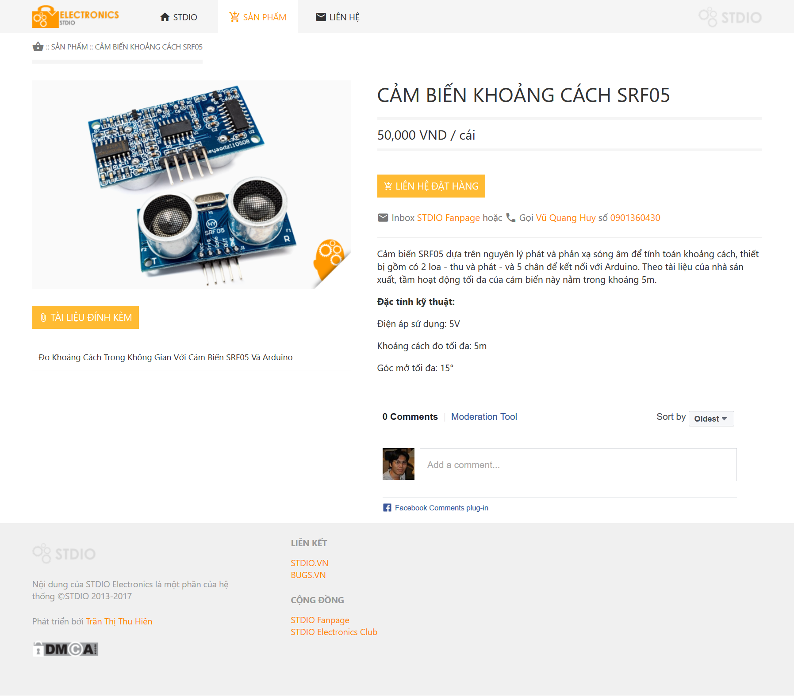
Components

Slide 8
Basic JSX Try it yourself!
const text = “Hello”;
{text}
const component = (<h1>Hello</h1>);
const component = <h1>Hello</h1>;
{node}
const FunctionComponent1 = () => {
return <h1>Hi!</h1>
};
{FunctionComponent1()}
<FunctionComponent1 />
const FunctionComponent2 = (name) => {
return <h1>{name}</h1>
};
{FunctionComponent2(“Vinh”)}
<FunctionComponent2 name=“Vinh”/>
const FunctionComponent3 = (name) => (
<h1>{“Name: ” + name}</h1>
);
{FunctionComponent3(“Vinh”)}
<FunctionComponent3 name=“Vinh”/>

